Slide 1








Welcome to the Team!
Key Stage 1
Fairytale Two Phase

Slide 2

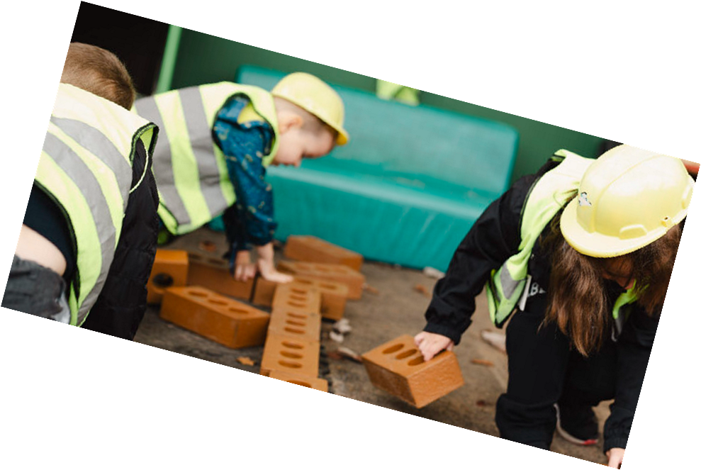
Key Stage 1 Staff team
Teaching Staff
Mrs Amanda Hayward
Miss Mandy Orland
Support staff
Miss Sam Morris
Mrs Reena Radia
Mrs Sithy Khan
Additional Support Team Members
Mrs Ras Sandhu
Miss Sarina Somal
Mr Noah Higgerson

Slide 3


The school day
Gates open 8.40am – 8.55am
Registration 8.50am – 8.55am
Morning Learning 9am – 12.15am
Lunch Break 12.15am – 1.15pm
Afternoon Learning 1.15pm-3.20pm

Slide 4
Uniform
P.E Kit
Navy, grey or black skirt, trousers or pinafore, (shorts in summer) blue summer dress
Blue shirt
Tie
Navy cardigan or jumper
Black shoes
White top
Blue or black shorts
Blue or black joggers and jacket or jumper
Trainers
Socks if girls are wearing tights in winter.
Please can all uniform and P.E kit be clearly named.
P.E kit can be kept in school for half term.

Slide 5



Learning in Key Stage 1

Slide 6
Learning in Key Stage 1
In Key Stage 1 children learn in a variety of different ways.
Children work independently following their learning input to complete their task and to demonstrate their understanding.
Children learn in small groups with an adult.
Children complete learning challenges online using an ipad to follow their learning programme including games and lessons. (Reading Eggs, Accelerated Reader and Maths Seeds.)
As well as focussing on the more academic skills we work on developing children's social, communication and language skills..

Slide 7
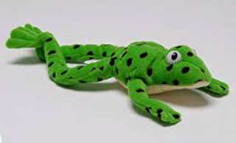


Homework – Reading
Read Write Inc Phonics book (familiar)
Read Write Inc Bookbag book (unfamiliar)
Sharing stories at bedtime is a great way to support your child to relax and spark your child’s love of stories.
Talk about what they heard and likes and dislikes.
Reading Eggs
These books will need to be in school everyday and there will be a Home – School agreement.

Slide 8
Homework
Spellings
Common Exception words
Can practice on Spelling Shed
No formal tests.
Maths
Key number facts
Maths Seeds
Children already know their login details for Maths Seeds and Reading Eggs

Slide 9
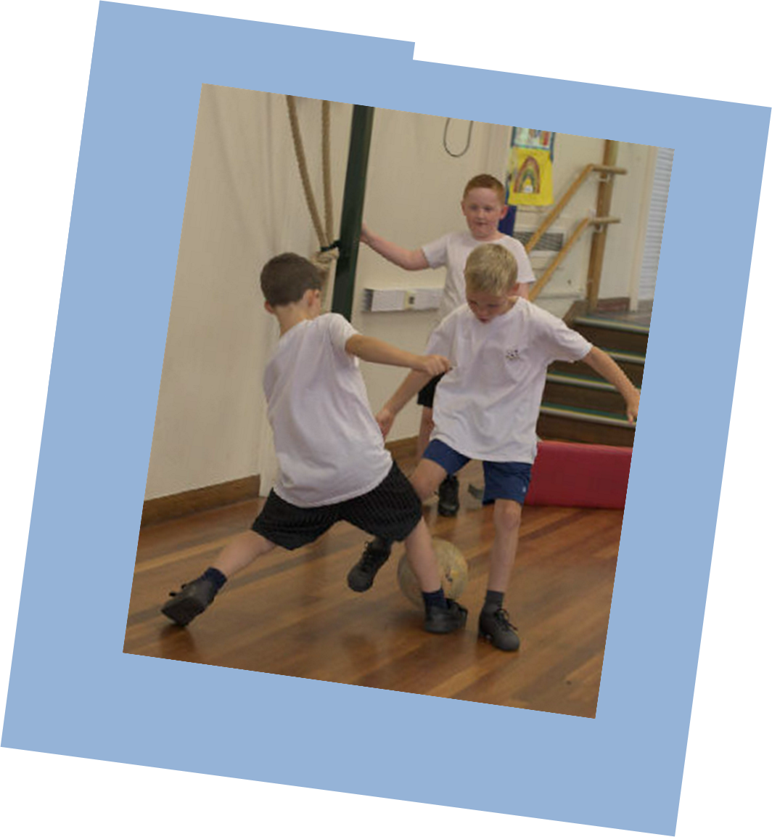
PE
Children have PE sessions led by specialist sports coaches.
Skills taught include:
Balancing
Ball skills
Running, stopping and command games
Gymnastics
Jumping
Throwing and catching (Target games)
Games - athletics
Additional PE sessions are led by our Dance teacher once a week.

Slide 10
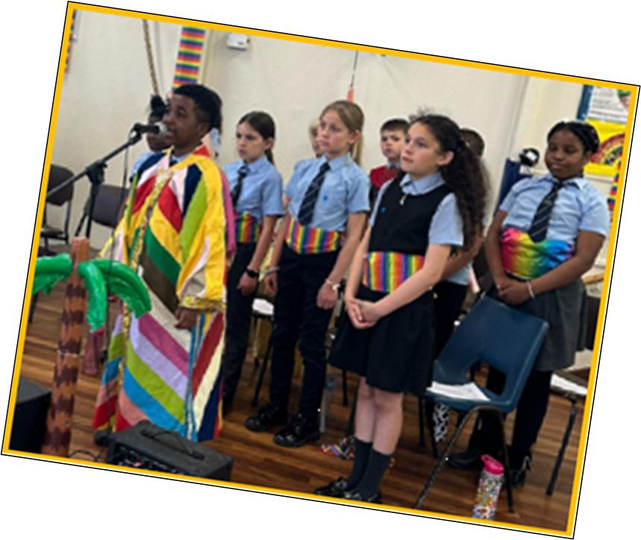
Experiences
We aim to enrich our curriculum with in school and out of school experiences.
Plans for this term:
Sharing our stories with families.
Expert DT day – Map making.
Expert Art day – House making
KS1 Carols and Nativity story
Autumnal creative afternoon
Christmas Fair

Slide 11

How to help at home
Encourage your child to read every day and listen to them read at least 4 times a week.
Practise key maths facts.
Ensure your child has a suitable bedtime, so that they can be wide awake and ready to learn in school.
Try to encourage them to have a healthy breakfast before coming to school.

Slide 12
Please ask the team if you want further information.
Thank-you for taking the time to read through this information.
Class Emails:

